Slide 1



AI DRIVEN LOAN RECOVERY PREDICTION
Created by Urielle Fotso

Slide 2


AGENDA
Introduction
Predictor Insight
Objective
Key Takeaways
Data Overview
Recommendations
Model Performance
Conclusion, references & appendix

Slide 3

INTRODUCTION
-Resource misallocation , missing high-value loans
-Lack consistency and data-driven prioritization
-Financial toll: Up to 7% loan portfolio loss during downturns from recovery failures(Dhaenens,2020, Global
Credit Data ).

Slide 4




OBJECTIVES
Develop an AI-driven predictive model to accurately forecast the recovery status of loans (Fully Recovered, Partially Recovered, or Written Off)
Recommend cost-effective recovery strategies, enabling our organization to maximize loan recovery rates while adhering to Canadian regulatory standards (FCAC/PIPEDA)

Slide 5
DATA OVERVIEW
-Data Sources: Internal loan performance records
-Volume: 500
-Variables:
.Number of missed payments,loan ID, burrower ID, recovery status, age ,gender
.EMI, loan type, legal action, payment history, loan amount
.Collection attempts

Slide 6
MODELING STRATEGY
·Modeling strategy
Step 1: Recovered (1) vs. Written Off (0)
Step 2: Fully Recovered (1) vs. Partially Recovered (0)
·Algorithms Used:
.Decision Tree
.Random Forest
.Logistic Regression

Slide 7
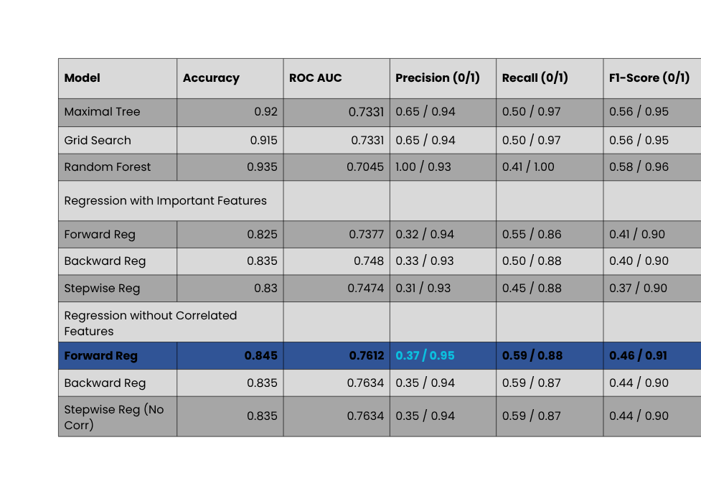
PERFORMANCE METRICS STEP 1

Slide 8
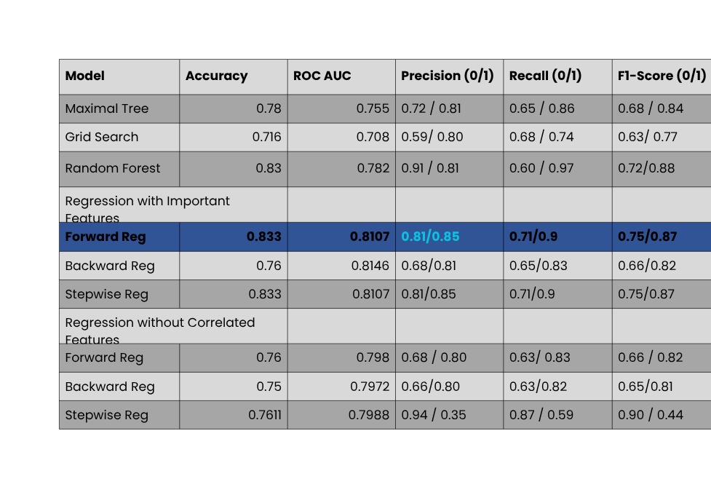
PERFORMANCE METRICS STEP 2

Slide 9
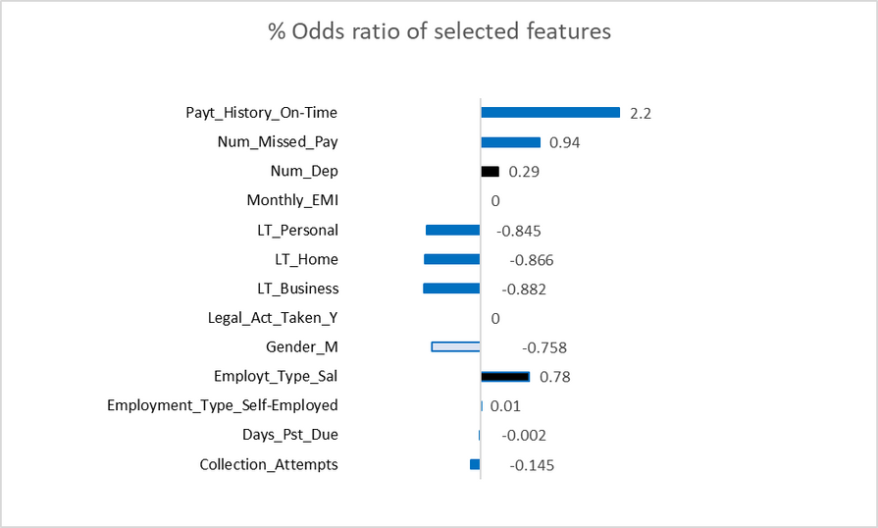

PREDICTORS INSIGHT STEP 1

Slide 10
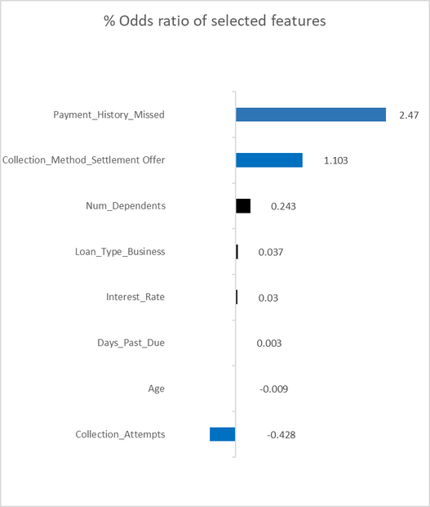
PREDICTORS INSIGHTS STEP 2

Slide 11

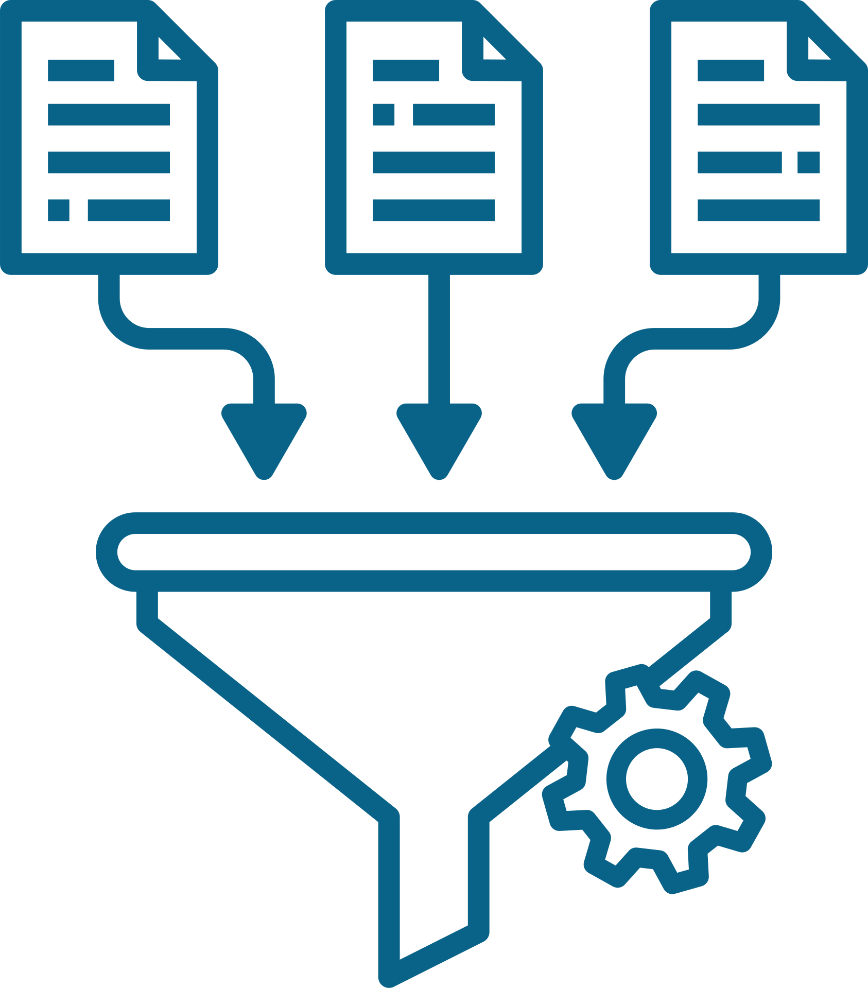




KEY TAKEAWAYS
Payment history on time
220%
of recovery
Settlement offer as collection method 110% of recovery
Business loan type
88 % of recovery

Slide 12

RECOMMENDATIONS
Implement loyalty-based retention programs (e.g., interest rate incentives, fee waivers) to maintain high repayment rates while minimizing collection cost
A
Incorporate settlement-based recovery strategies, especially for delinquent accounts flagged as having moderate recovery potential, to increase resolution rates while reducing prolonged collection costs.
B
Introduce stricter credit assessments and collateral backed lending for new business loans . For existing high risk accounts, apply early settlement negotiations to mitigate write-offs
C

Slide 13
CONCLUSION
By harnessing AI to predict high-potential loans, we could unlock a path to more recoveries and less cost, adding millions to our bottom line. This model not only drives profitability but also empowers our teams and builds trust with customers and regulators through full FCAC/PIPEDA compliance

Slide 14
THANKS FOR YOUR ATTENTION
Q & A

Slide 15
REFERENCES
Global Credit Data. (2020, October 20). Downturn LGD Study 2020. Retrieved from Global Credit Data website: https://globalcreditdata.org/library/downturn-lgd-study-2020

Slide 16
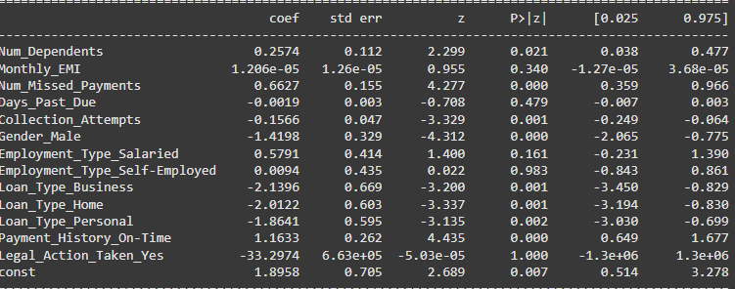
APPENDIX
FCAC; Financial Consumer Agency of Canada
PIPEDA; Personal Information Protection and Electronic Documents Act
Forward regression odds statistic STEP 1

Slide 17
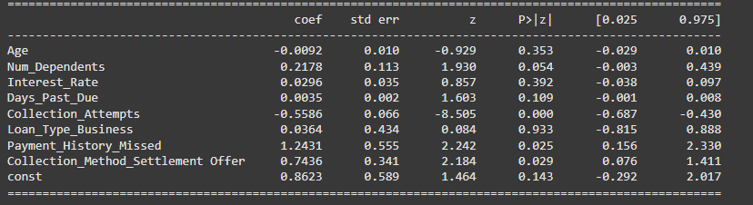
APPENDIX
Forward regression statistic significance STEP 2

